Slide 1



Audit Management System
SIGTERM
Harman Singh
Nitin
Pranav Aggarwal
Saket Ahlawat
Nitin Singh

Slide 2





WebD
WebD
WebD
Product Management
AI/ML

Slide 3





PROBLEM
Inconvenience in Troubleshooting
Compliance and Accountability Concerns
Data Inconsistencies and Errors
Data Loss and Recovery Challenges

Slide 4
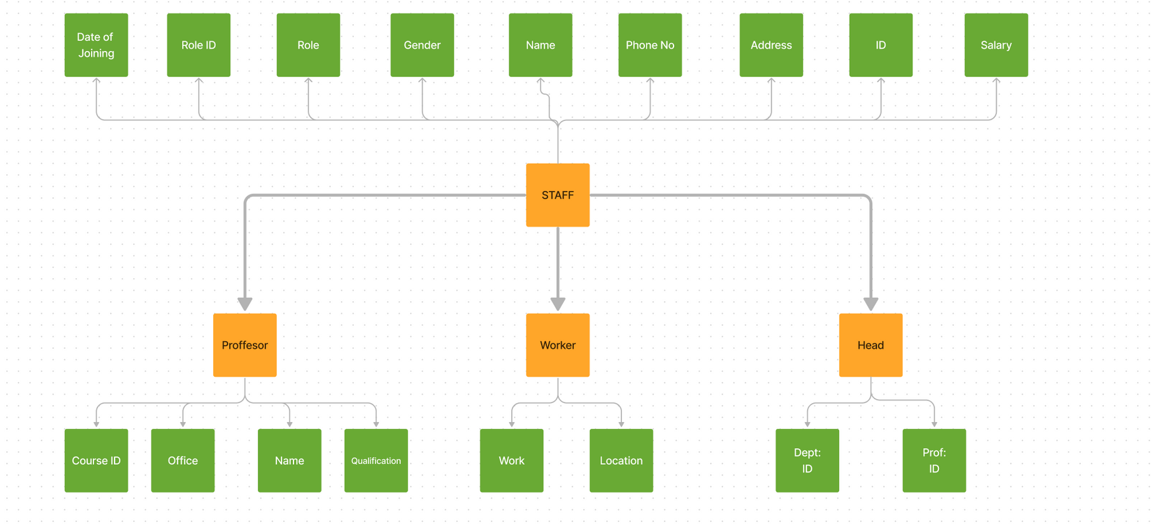
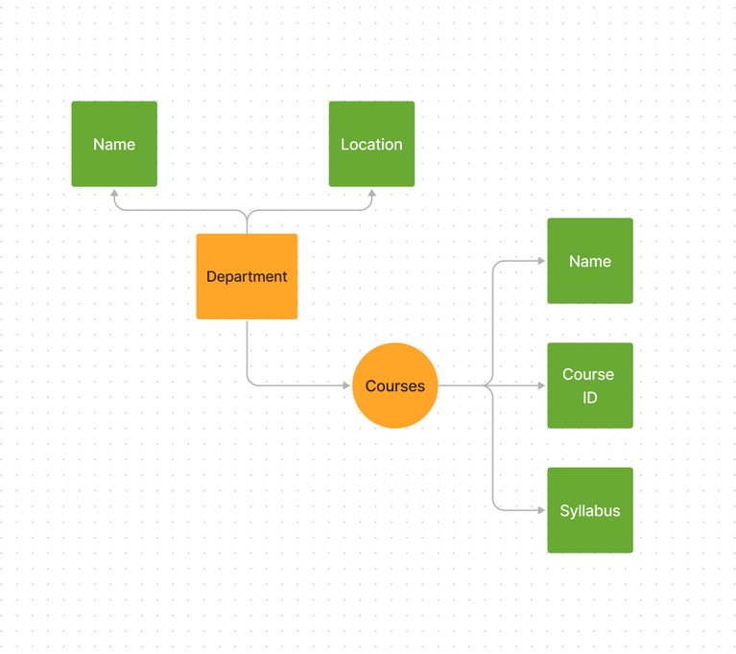
DATABASE SCHEMA AND RELATIONSHIP
DEPARTMENT BLOCK
STAFF BLOCK

Slide 5
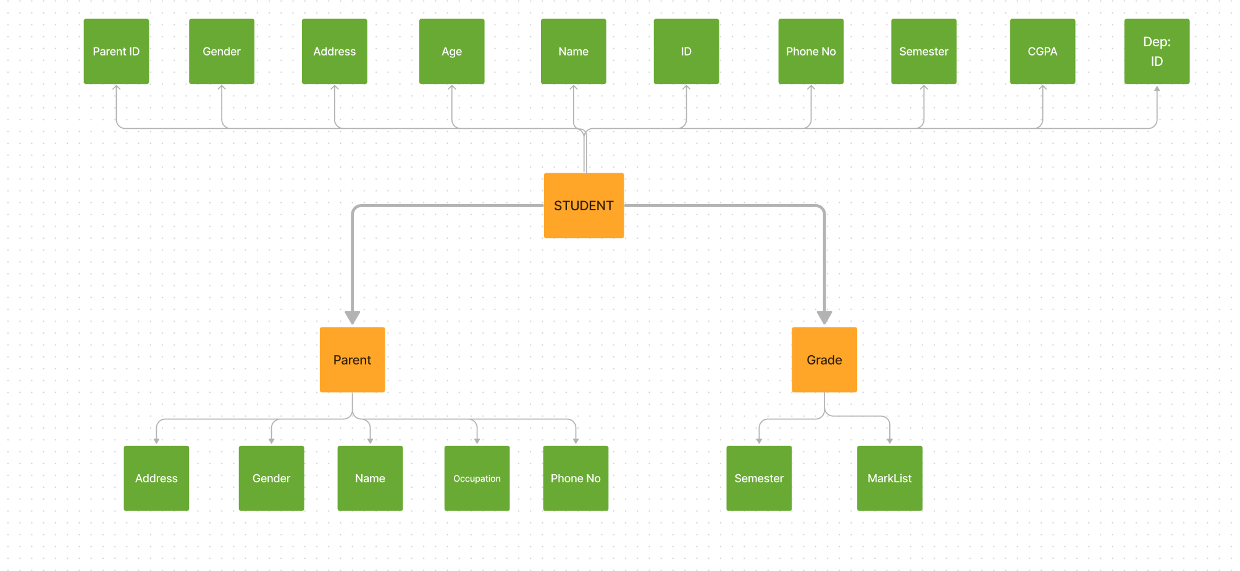
STUDENT BLOCK

Slide 6

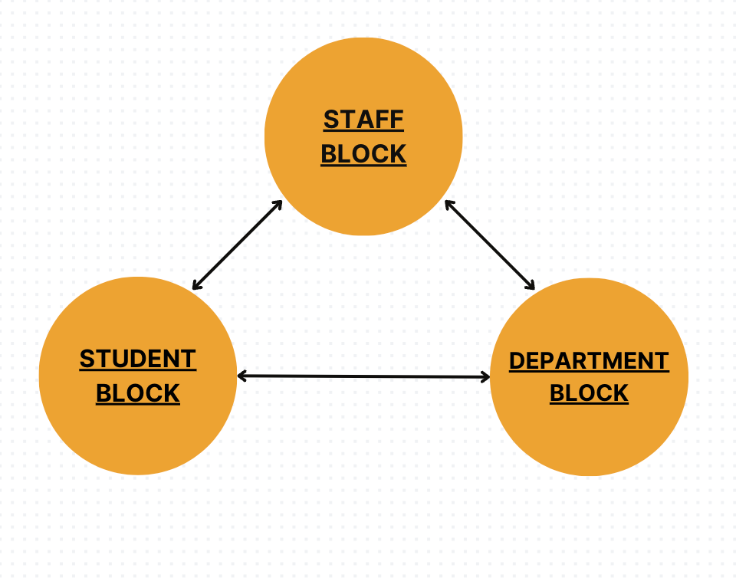
Interconnection of different blocks

Slide 7

SOLUTION
S No: | Key Components
1) 2) 3) 4) 5) 6) | Change History Viewer. Management Dashboard CRUD Operations Activity Logging Inter-relational queries Reverting Back

Slide 8

Application
Features
1) History Viewer:
The Change History Viewer is the data's time machine, offering a clear record of all changes made to employee or student data, ensuring transparency, accountability, and enhanced data security. It's the ultimate tool for maintaining accurate and reliable information.
2) Management Dashboard:
Our user-friendly data maintenance dashboard provides a seamless experience for tracking changes. It displays both the original and updated values, offering a comprehensive audit history at fingertips, making data management efficient.

Slide 9
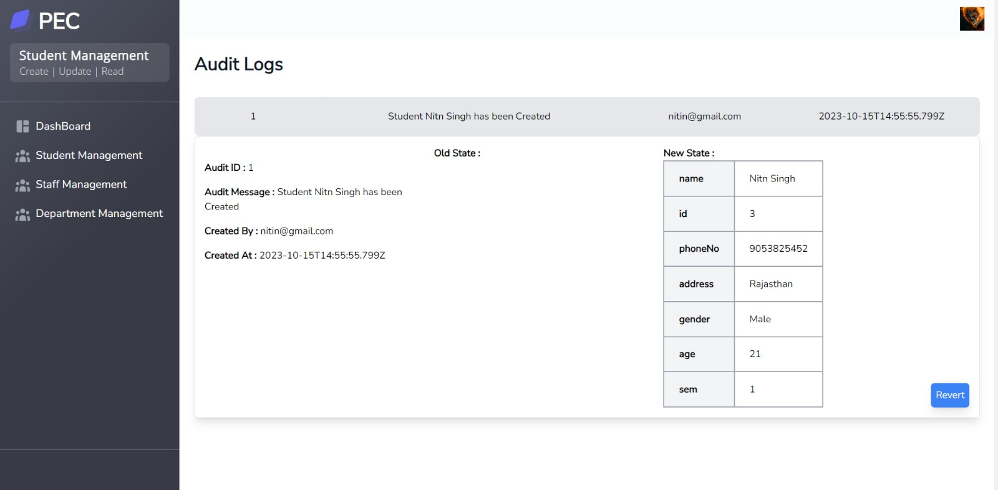

Slide 10
3) CRUD Operations:
Our application offers a robust platform to efficiently manage employee or student data, enabling Create, Read, Update, and Delete (CRUD) operations with ease.
4) Activity Logging:
Activity Logging is like cloning a replica of a higher level environment like production environment using audits for troubleshooting the problems which occurs during the execution of audit in the production environment.

Slide 11
5) Inter-relational queries:
Our system enables user to perform advanced queries based on various interconnected data fields like Employee ID, Phone Number, or Department. Plus, it also includes an audit trail for the queried data, ensuring you have a complete history for all your inquiries.
6) Reverting Back:
Upon inquiring about a previous audit, our app uses a recursive way to recreate an entity by replaying all audit records up to a specified point, effectively restoring a record to a previous state.

Slide 12





Potential Addressable Market For the Product
Educational Institutions
The product has great potential to cater the growing demands of database management in some of the following mentioned sectors.
Healthcare Providers
Financial Institutions
Audit and Consulting Firms

Slide 13


